Slide 1
DATABASE MANAGEMENT
SYSTEMS
CENG-3005
SUDE EBRAR ÇAT - 200709007
ERKİN ALKAN - 200709060
BARAN İŞCİ - 200709054

Slide 2
OUR DATASET
This dataset comes from a comprehensive Item Catalog for Animal Crossing New Horizons (ACNH).
ACNH is a life simulation game released by Nintendo. In New Horizons, the player assumes the role of a customizable character who moves to a deserted island. Taking place in real-time, the player can explore the island in a nonlinear fashion, gathering and crafting items, catching insects and fish, and developing the island into a community of anthropomorphic animals.

Slide 3
More about
The data was collected by a dedicated group of AC fans who continue to collaborate. The database contains the original data and full list of contributors and raw data.
ROW
COLUMN
There are 3275 rows in our dataset.
There are 32 columns in our dataset.

Slide 4
ATTRIBUTES
Name: Names of items. (acoustic guitar, screen, pet bed, garbage bin)
Variation: The slight difference in specific items. (Bronze, Oak, Birch, Octopus)
Body Title: Categorization of items. (Fruit type, Mushroom type, Cover design)
Pattern: Visualization pattern of items. (Navy design, Blue stripes, Waves, Dots)
Pattern Title: Categorization of items which has pattern. (Table, Cloth, Lamp, Bedding, Flag)
DIY(Do It Yourself): Items which is craftable or not. (Yes, No)
Body Customize: Items which has body customize or not. (Yes, No)
Pattern Customize: Items which has pattern customize or not. (Yes, No)
Kit Cost: Customization price of items. (null, 1, 3, 5)
Buy: Purchase cost of items. (870, 1100, 3200, 2300)
Sell: Sell price for items. (230, 1225, 1110, 1100)

Slide 5
ATTRIBUTES
Color 2: Secondary color of item. (Pink, Gray, Brown, Yellow)
Size: Pixel size of item in game. (1x1, 3x1, 2x2, 3x3)
Miles Price: Special price of items. (2400, 1000, 4000, 3000)
Source: The place which item comes from. (Nook’s Cranny, Crafting, Starting Item)
Source Notes: Explanation of sources. (Available in Nook's Cranny (either upgrade tier) in the unique furniture slot.)
Version: Version of game which item comes. (1.0.0, 1.1.0, 1.2.0)
HHA (Happy Home Academy) Concept 1: Main place where item belongs dedicated by HHA. (living room, kitchen, music, concert)
HHA Concept 2: Secondary place where item belongs dedicated by HHA.(garden, fitness, school, space)
HHA Series: Categorization of items dedicated by HHA. (Wooden, Frozen, Iron, Mush)
HHA Set: Combination of items dedicated by HHA. (bear, birthday, lecture hall, pet)
Interact: Player can interact or not. (Yes, No)

Slide 6
ATTRIBUTES
Tag: Tag of item. (Desk, Chair, Bed, Dresser)
Outdoor: Is item outdoor or not. (Yes, No)
Speaker Type: If it has speaker which type it is. ( Hi-fi, Retro, Does not play music)
Lighting Type: If it has lightning which type it is. (Candle, Spotlight, Fluorescent, No lighting)
Catalog: It says if item is salable or not. (For sale, Not for sale, Not in Catalog)
Filename(Unique): File name of item.
Variant_ID: Variation ID of item
Internal_ID: Name ID of items.
Unique Entry ID: Unique ID of items.

Slide 7
QUESTIONS
1-What is the minimum "buy" price among all items in the "trade" table?
2-How many unique entries are there in the "items" table, and what is the minimum "buy"?
3-What is the minimum "kit cost" for items in a specific "catalog"?
4-What is the maximum "sell" price and the minimum "buy" price among all items in the "trade" table?
5-How many items in the "items" table have the "DIY" (Do-It-Yourself) option set to "Yes"?

Slide 8
QUESTIONS
6-What is the minimum "miles_price" for all items in the "trade" table?
7-What is the average "size" and the minimum "size" of items in the "interactions" table for a specific "speaker_type"?
8-How many items in the "items" table have customization options for both "body" and "pattern"?
9-What is the sum of "sell" and the minimum "size" for items in the "interactions" table for a specific "outdoor" category?
10-What is the count of items with a specific "color_1" in the "color" table for a certain "hha_concept_1"?

Slide 9
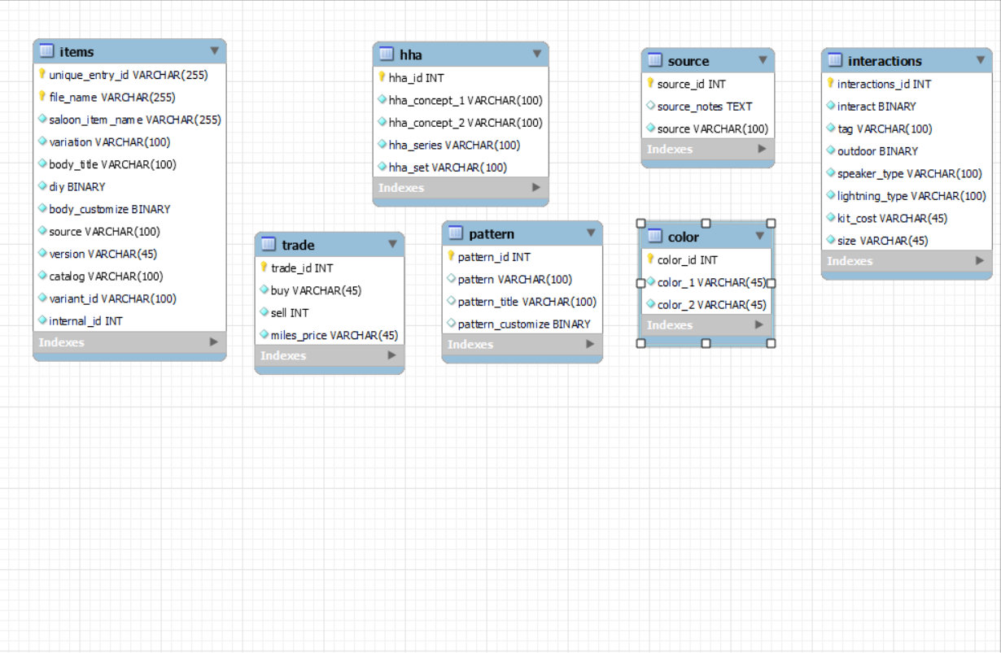
EXAMPLE ENTITY TABLE

Slide 10
Source
https://www.kaggle.com/datasets/jessicali9530/animal-crossing-new-horizons-nookplaza-dataset?select=housewares.csv

Slide 11
THANK YOU

